Slide 1
Network Dissection: Quantifying Interpretability of Deep Visual Representations
Authors: David Bau∗, Bolei Zhou∗, Aditya Khosla, Aude Oliva, and Antonio Torralba
CSAIL, MIT
Presenter: Utku Acar

Slide 2
What is the objective of this paper?
Present a framework called Network Dissection that measures how well different parts of Convolutional Neural Networks (CNNs) capture specific concepts to understand how clear and separate these representations of concepts are.

Slide 3
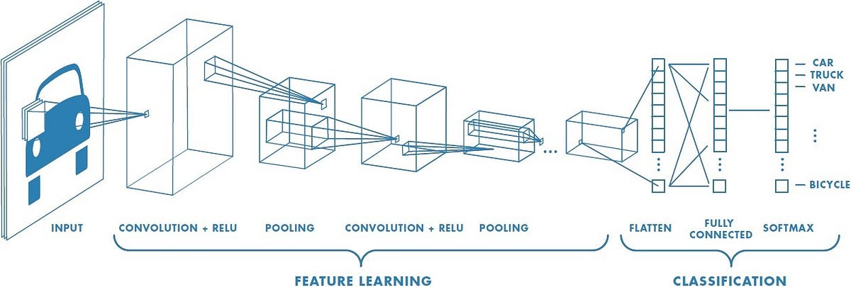
What are Convolutional Neural Networks (CNNs)?[1]
A class of deep learning models specifically designed for processing and analyzing visual data.

Slide 4
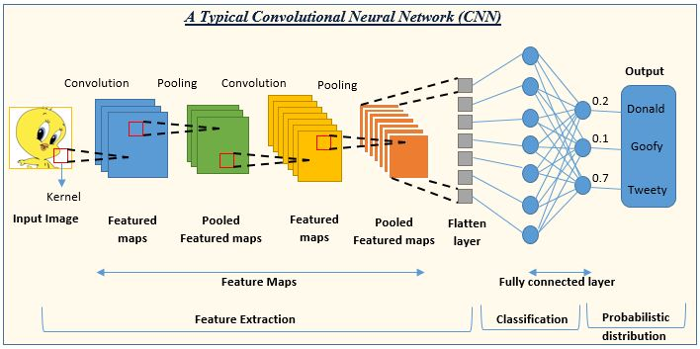
Which layers does the CNN have?[2]
CNNs are composed of multiple layers:
convolutional layers,
pooling layers,
fully connected layers,
Which enable them to automatically and adaptively learn spatial hierarchies of features from input images.

Slide 5





How does Convolution operation work?[3]

Slide 6
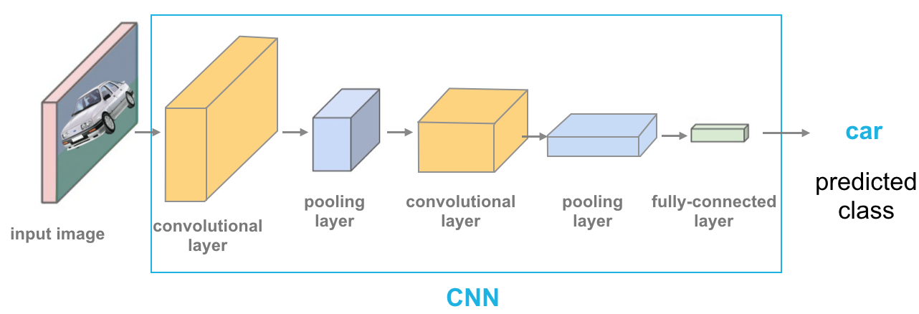
What are the advantages of these layers?[4]
Effectively capture patterns, textures, and complex structures within visual data, making them highly effective for tasks such as image classification, object detection, and image segmentation. The ability of CNNs to learn and extract meaningful features from raw visual data has revolutionized the field of computer vision, enabling advancements in areas such as autonomous vehicles, medical imaging, and facial recognition.

Slide 7
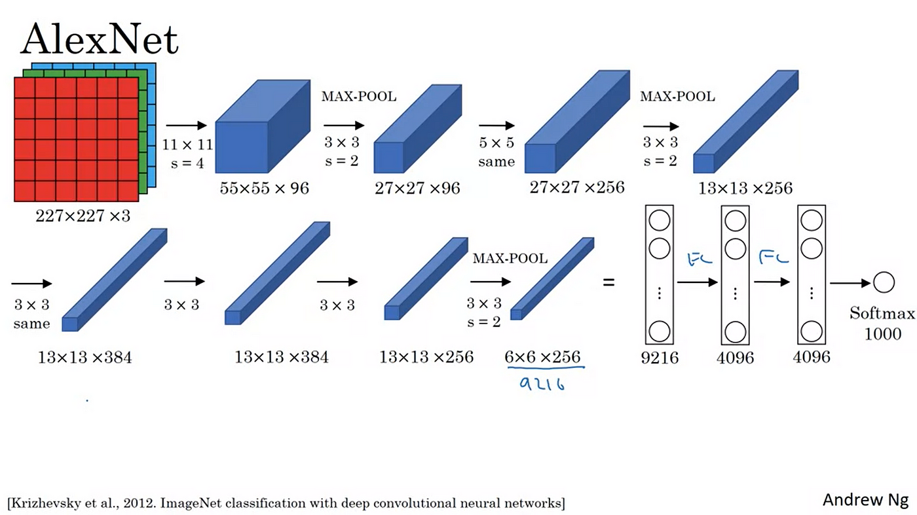
Alexnet[5]

Slide 8
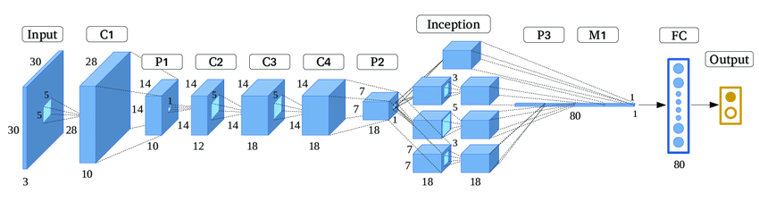
GoogleNet[6]

Slide 9
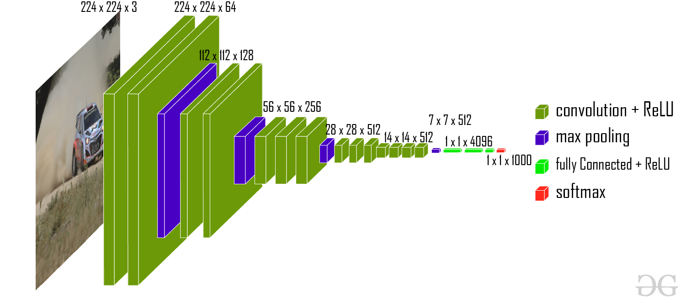
VGG-16[7]

Slide 10
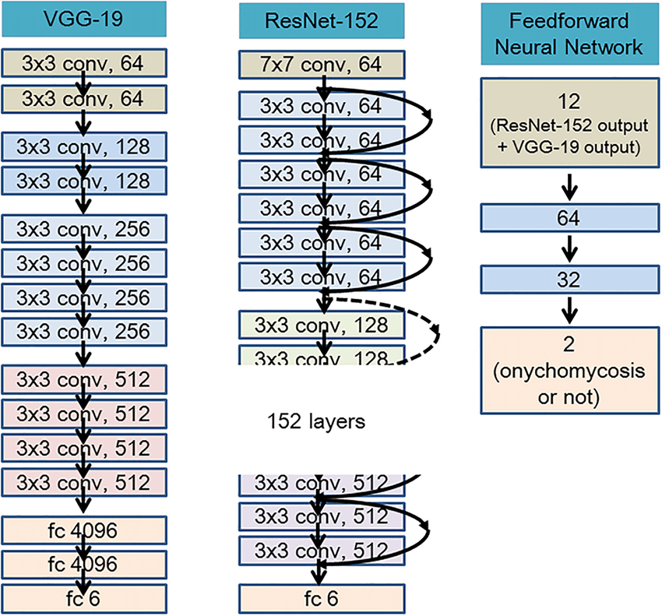
ResNet-152[8]

Slide 11
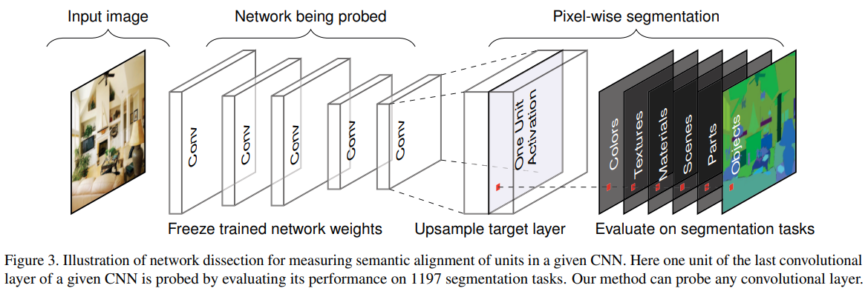
General Structure of Network Dissection[9]

Slide 12
Numerical info about Datasets[9]
Broadly and Densely Labeled Dataset (Broden):
Scene: 468 classes, Average samples: 38
Object part: 584 classes, Average samples: 491
Material: 234 classes, Average samples: 854
Texture: 32 classes, Average samples: 1,703
Color: 47 classes, Average samples: 140
ImageNet:
Object-centric dataset
1.2 million images from 1000 classes
Places205:
Scene-centric dataset
2.4 million images from 205 scene categories
Places365:
Scene-centric dataset
1.6 million images from 365 scene categories

Slide 13
Step-by-Step Approach[9]
Identify a broad set of human-labeled visual concepts: Identifying a diverse range of human-labeled visual concepts, including objects, scenes, object parts, textures, materials, and colors. This is achieved using the Broadly and Densely Labeled Dataset (Broden), which unifies several densely labeled image datasets.

Slide 14
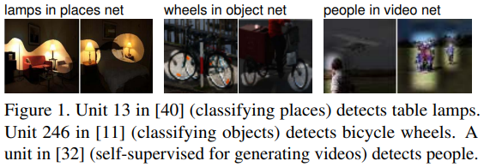
Identify a broad set of human-labeled visual concepts[9]

Slide 15

Step-by-Step Approach[9]
Gather hidden variable's response to known concepts: Collect the response of hidden variables in the CNN to the known human-labeled concepts. This involves evaluating the alignment between individual hidden units and a set of semantic concepts, measuring the interpretability of the representations.

Slide 16
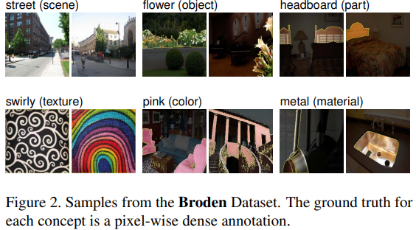
Samples from Broden with annotations[9]

Slide 17
Step-by-Step Approach[9]
Quantify alignment of hidden variable-concept pairs: Quantifying the alignment between individual hidden units in the CNN and the set of semantic concepts provides insights into the disentangled nature of the representations. This step also includes human evaluation of interpretations using Amazon Mechanical Turk (AMT) to validate the interpretability of the units.

Slide 18
Step-by-Step Approach[9]
Human interpretation: The human evaluation of interpretations is conducted using AMT, where raters are shown images with highlighted patches representing the most highly activating regions for each unit in a CNN trained on Places205. Raters are asked to determine whether a given phrase describes most of the image patches. The results are summarized to determine the set of interpretable units, the portion of interpretations generated by the method that were rated as descriptive, and the human consistency based on a second evaluation of ground-truth labels.

Slide 19
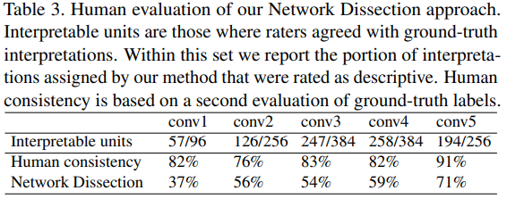
Quantify alignment of hidden variable-concept pairs & Human Interpretation[9]

Slide 20
What is The Human Evaluation of Interpretations?[9]
Assessing the quality and validity of unit interpretations generated by automated systems, such as natural language processing or machine learning models, using human judgment.

Slide 21
Examples of Human Evaluation [9]
Amazon's Mechanical Turk: Well-known example of a crowdsourcing platform where human workers perform various tasks that computers can't easily do.
Toloka: Just like Mechanical Turk, Toloka enables businesses and researchers to access human judgments and input for tasks that are challenging for purely automated systems. Users on Toloka can perform these tasks for compensation, contributing to the development and improvement of AI technologies.
Clickworker: Similar to Mechanical Turk, Clickworker offers a platform for individuals to complete microtasks, ranging from data categorization to content creation.
CrowdFlower: This platform provides services for data enrichment and AI training data through human-in-the-loop workflows.
Upwork: While broader in scope, Upwork allows businesses to hire freelancers for tasks that can include data entry, content writing, and more, resembling a manual labor force for digital tasks.

Slide 22
What are Amazon's Mechanical Turk's other use cases?[9]
Evaluating the interpretability and accuracy of text summarization systems
Evaluating the coherence and relevance of topic models
Evaluating the plausibility and diversity of counterfactual explanations
Evaluating the persuasiveness and trustworthiness of argumentation systems

Slide 23
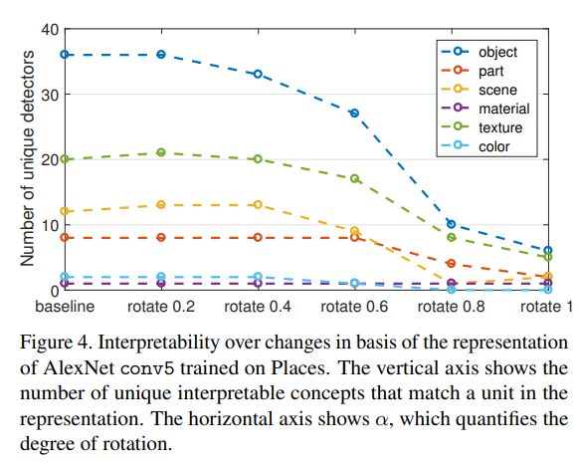
Change on Interpretability with Rotation[9]

Slide 24
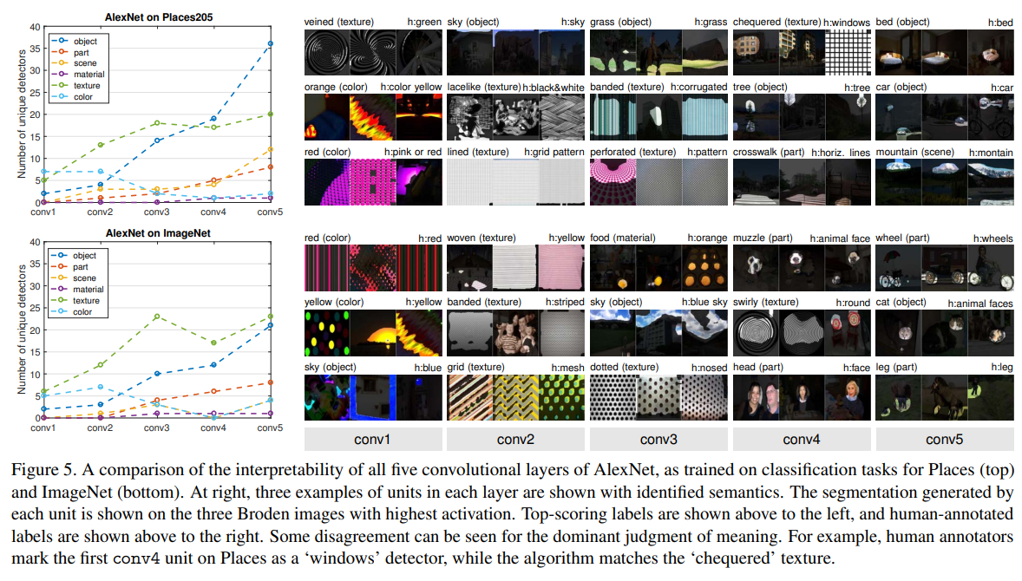
Interpretability Comparision of Convolutional Layers[9]

Slide 25
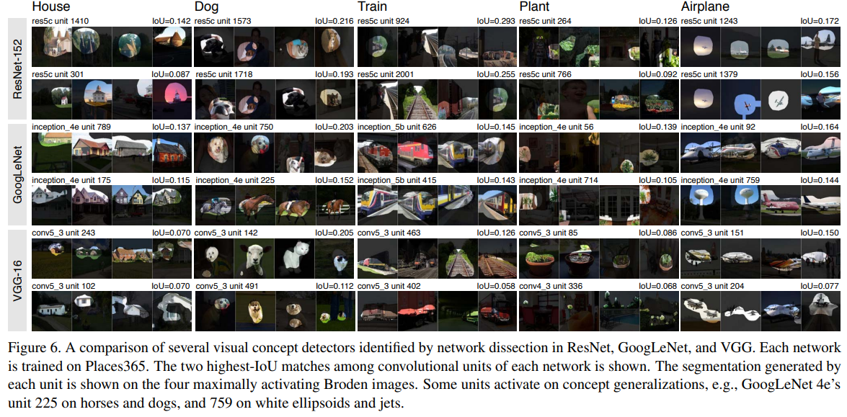
Interpretability Comparision of Models[9]

Slide 26
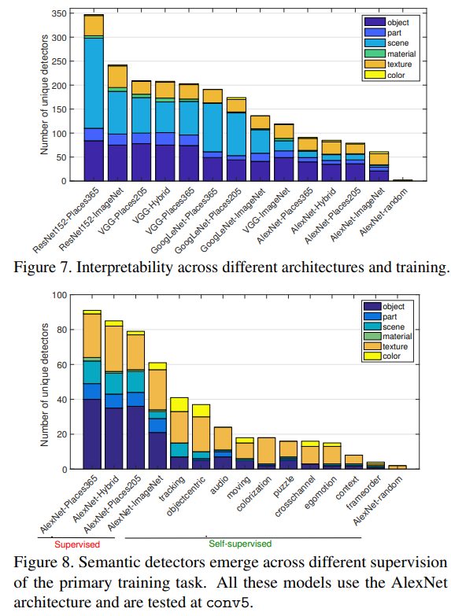
InterpretabilityComparison among different models[9]

Slide 27
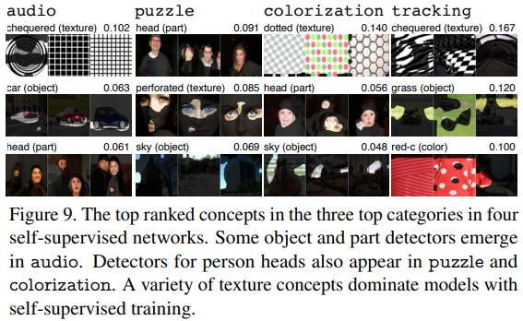
Most Meaningful Concepts on Different Datasets[9]

Slide 28
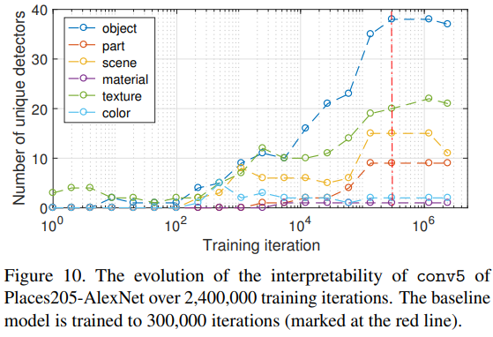
Interpretability vs Iteration[9]

Slide 29
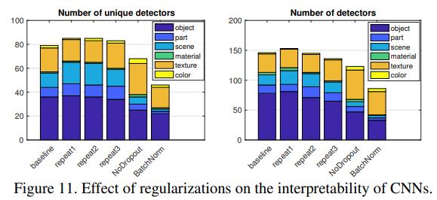
Effect of Regulations on the Interpretability[9]

Slide 30
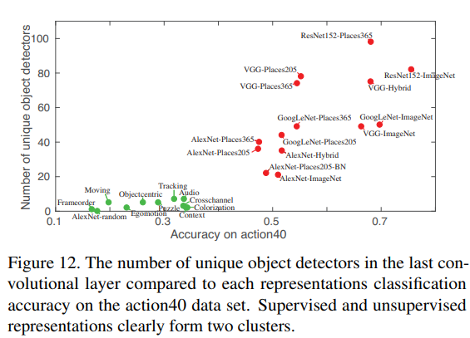
Interpretability vs Accuracy[9]

Slide 31
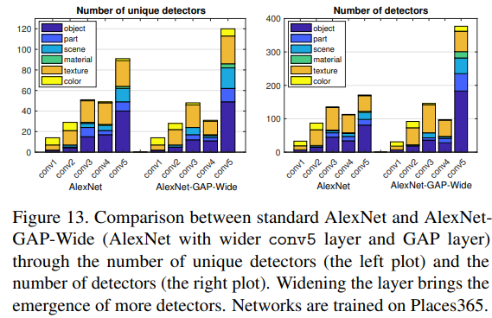
Interpretability vs Model Width[9]

Slide 32
Sources
[1] "Sustainability," MDPI, vol. 15, no. 18, 13990. [Online]. Available: https://www.mdpi.com/2071-1050/15/18/13990
[2] "Sustainability," MDPI, vol. 15, no. 18, 13723. [Online]. Available: https://www.mdpi.com/2071-1050/15/18/13723
[3] D. Key, "Giphy," [Online]. Available: https://giphy.com/gifs/blog-daniel-keypoints-i4NjAwytgIRDW
[4] "Coding Convolutional Neural Networks (CNN) with TensorFlow," Medium, Analytics Vidhya, [Online]. Available: https://medium.com/analytics-vidhya/coding-convolutional-neural-networks-cnn-with-tensorflow-2b72647a522c
[5] "Alexnet architecture," ResearchGate, [Online]. Available: https://www.researchgate.net/figure/Alexnet-architecture_fig1_358078749
[6] D. Singh, "Implementation of GoogLeNet CNN," Medium, [Online]. Available: https://medium.com/@singhdewansh99/dlao-part-16-implementation-of-googlenet-cnn-c2a4435d8995
[7] "Image classification on CIFAR-10 dataset," AIMind, [Online]. Available: https://pub.aimind.so/image-classification-on-cifar-10-dataset-1183117802ce
[8] "The representation of model architecture image for ResNet-152, VGG-19, and two-layered," ResearchGate, [Online]. Available: https://www.researchgate.net/figure/The-representation-of-model-architecture-image-for-ResNet-152-VGG-19-and-two-layered_fig2_322621180
[9] "Very Deep Convolutional Networks for Large-Scale Image Recognition," arXiv, 1704.05796, [Online]. Available: https://arxiv.org/pdf/1704.05796.pdf

